Slide 1

Networking Terminologies
MAC (Media Access Control) Address (Layer 2 - Data Link) is the physical address of the Networking Interface, ensures that data sets gets to your destination.
IP (Internet Protocol) [Layer 3 Network] Address is the unique address on the network.
Subnet (Subnetwork) Separates the IP into network and host addresses.
Gateway is the connection leading outside of the local network.
DNS (Domain Name System) Host translates hostnames into IP addresses.
DNS Domain is the lookup domain for the host.
Switches forward packets within the internal network.
Routers forward packets between networks; it is a layer 3 (network) device.
TCP and UDP (Layer 4 Transport): are Transport Protocols. TCP is reliable, connection-oriented while UDP is connection-less (DNS uses it)
ICMP is used to test connectivity by ping command.
Sockets in Linux is used to establish communication between 2 processes.

Slide 2
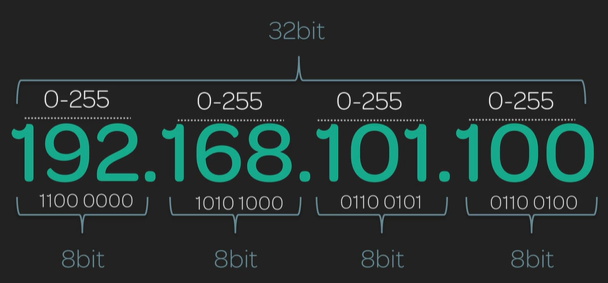
IPv4 Address
It is the address of your device on its network.

Slide 3
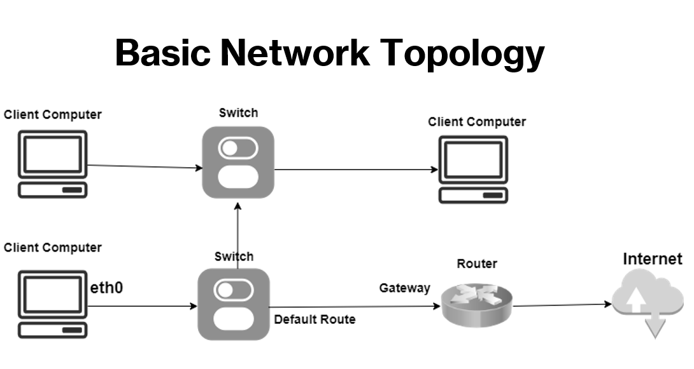

Slide 4
Linux Networking Commands
ip addr (replacement for ifconfig)
lo: loopback interface with ip of 127.0.0.1
eth0: IP Address of the device
nmcli
nmcli device show
ip route show
systemctl status NetworkManager
cat /etc/services (list of well-known ports)
ss -4 -ta
dnf install bind-utils -y
nslookup google.com
dig google.com

